Slide 1
Azure Data Overview

Slide 2
Agenda
SQL Database
SQL Server VM
DocumentDB
Search
HDInsight
Additional Databases
Notes:
The Azure data Platform is HUGE and growing. This session will have to be brief about some of this content and make a few deep dives here and there.

Slide 3
SQL Database
Notes:
Now let’s focus on Microsoft Azure SQL Database the PaaS service!

Slide 4

Microsoft Relational Storage Options
A Continuous offering
Physical
Virtual
IaaS
PaaS
From private to public Cloud
Notes:
Slide Objectives:
Show Microsoft’ continuous Private to Public Cloud Offering, but this presentation will focus on Microsoft’s relational database PaaS offering.
Transition:
Microsoft provides a continuous solution from private cloud to the public cloud. No matter where you are on your technology roadmap we have a solution to fit your needs.
We are a trusted advisor and platform in the traditional enterprise and ISV space with new IaaS offerings that making it easier to bring this same level of trust and ease of use to the public cloud. However, Microsoft Azure SQL Database extends SQL Server capabilities to the cloud by offering SQL Server as a relational database service.
Speaking Points:
SQL Database provides SQL Server as a relational service.

Slide 5


SQL Database
Fully managed SQL Server database technology as a service
Ideal for simple and complex applications
Enterprise-ready with automatic support for HA
Secondary
Replica
Primary
Secondary
Replica
Secondary
Replica
Notes:
Speaker notes:
How is HA achieved? At any one time, three database replicas are running—one primary replica and two or more secondary replicas. If the hardware fails on the primary replica, Azure SQL Database detects the failure and fails over to the secondary replica. In case of a physical loss of a replica, a new replica is automatically created. So there are always at minimum two physical, transitionally consistent copies of your data in the datacenter.

Slide 6
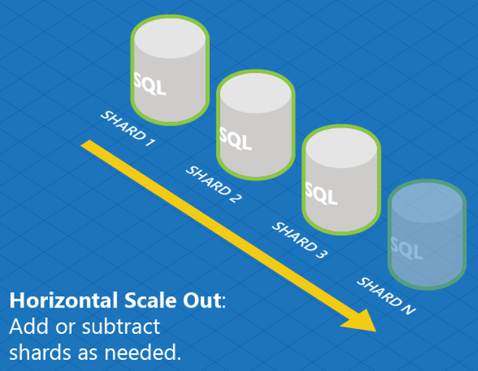
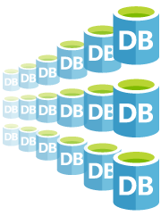
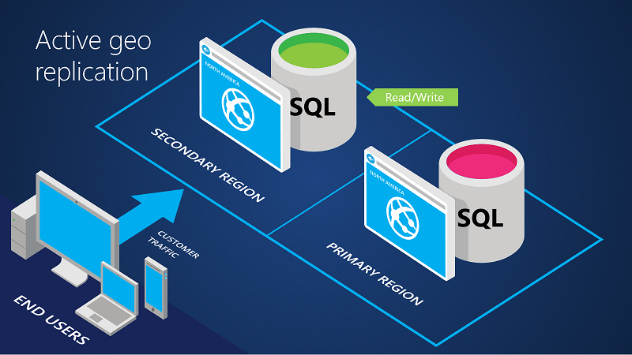
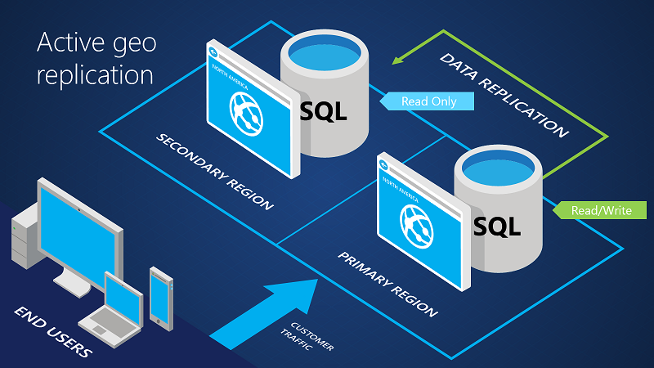
SQL Database
Designed to scale out elastically with demand
Robust Failover and Disaster Recovery capabilities
Cross Datacenter Failover
Notes:
Speaker notes:
Azure SQL Database Elastic Scale capabilities simplify the process of scaling out (and in) a cloud application’s data tier by streamlining development and management. Based on industry-standard sharding practices, Elastic Scale offers functionality to help you build and maintain applications that can span a few databases or thousands.
On top of the built-in systems that enable HA of your database, Azure SQL Database offers additional business continuity features:
The active geo-replication support enables you to initiate/control any failovers – allowing you to shift the primary database to any of your secondary regions.
The built-in backup and restore capabilities offered by Azure SQL Database provide great functionality for recovering from disaster and human error (oops mistakes).

Slide 7
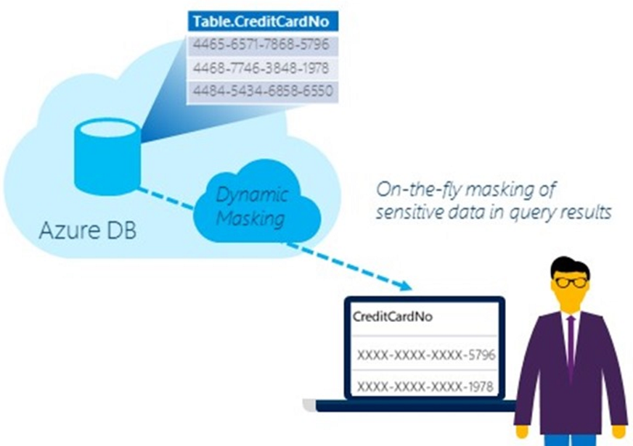
SQL Database
Compliant with industry regulations and policies
Secured Encrypted Database Files
Limit exposure of sensitive data
Protect Sensitive Data
Notes:
Speaker notes:
Transparent Data Encryption (TDE) is used to encrypting a customer’s Azure SQL database at rest in real-time to help protect against the threat of malicious activity. In a scenario where the physical media (such as drives or backup tapes) are stolen, a malicious party can’t restore or attach the database and browse the data without the encryption keys.
Limit the exposure of sensitive data in Azure SQL Database using Dynamic Data Masking to meet industry compliance policies.

Slide 8
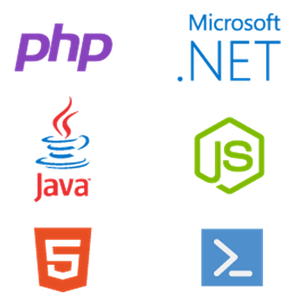
SQL Database
Full support for TDS and ODBC
Familiar language and framework support
Notes:
Speaker Notes:
Microsoft Azure SQL Database supports tabular data stream (TDS) protocol client version 7.3 or later. Earlier versions of TDS protocol are not supported.
You can use Configuring ODBC Data Sources to define user and system data sources for Microsoft Azure SQL Database.
Drive productivity through support for familiar functionality, tools and platforms

Slide 9
Architecture
Starting with the basics

Slide 10
A Server is not a machine
SQL Server
Machine
(Physical/VM)
Azure
SQL Database Server
TDS Endpoint
Notes:
Slide Objectives:
Understand that while there are physical SQL Server boxes behind the scenes, when connecting to SQL Database, you are not connecting to a physical server, but to a TDS endpoint.
Transition:
The key to understanding SQL Database is understanding while SQL Database is SQL Server, we do not interact with them in the same physical manner.
Speaking Points:
In an on-premises environment, we typically have physical access to the actual SQL Server server.
In Microsoft Azure, we do not have physical access to the actual server.
Notes:
It is important that the attendee understands that it IS INDEED SQL Server at the platform layer. There are physical boxes running SQL Server 2012 Enterprise Edition. However, due to the nature of the Azure environment to provide the high-availability and scalability necessary, access to the physical boxes is currently not supported.

Slide 11
SQL Database The Basics
SQL Server database technology “as a Service”
Fully Managed
Enterprise-ready with automatic support for HA, DR, Backups, replication and more
Notes:
Slide Objectives:
Understand the overall concepts and benefits of SQL Database
Transition:
Let’s clear up any confusion and look at the basics of what SQL Database really is and some of its benefits.
Speaking Points:
The same great SQL Server database technology that you know, love, and use on-premises provided as a service
Enterprise-ready
Automatic support for High-Availability
Designed to scale on-demand to provide the same great elasticity
Notes:
High-availability – 3 copies of the database free for the cost of the one database. Always in sync. The cost to do this on-premises isn’t cheap. This is FREE in SQL Database.

Slide 12
SQL Database The Basics
Scale out with ElasticScale
Built-in regional database replicas for additional protection
Uptime SLA of 99.99%
Notes:
Slide Objectives:
Understand the overall concepts and benefits of SQL Database
Transition:
Let’s clear up any confusion and look at the basics of what SQL Database really is and some of its benefits.
Speaking Points:
The same great SQL Server database technology that you know, love, and use on-premises provided as a service
Enterprise-ready
Automatic support for High-Availability
Designed to scale on-demand to provide the same great elasticity
Notes:
High-availability – 3 copies of the database free for the cost of the one database. Always in sync. The cost to do this on-premises isn’t cheap. This is FREE in SQL Database.

Slide 13
How It Works – Architecture of the Service
Client Layer
PHP
SQL Server
Applications
and Tools
WCF Data Services
Applications communicate directly with SQL Database using TDS.
ODBC
ADO.NET
Tabular Data Stream (TDS)
Notes:
Client - The client layer resides closest to your application, and is used by your application to communicate directly with SQL Database. The client layer can reside on-premise in your datacenter or be hosted in Microsoft Azure. Because SQL Database provides the same tabular data stream (TDS) interface as SQL Server, you can use familiar tools and libraries to build client applications for data that is in the cloud.

Slide 14
How It Works – Architecture of the Service
Client Layer
PHP
SQL Server
Applications
and Tools
WCF Data Services
ODBC
ADO.NET
Tabular Data Stream (TDS)
TDS+SSL
Gateway between Client layer and Platform layer.
Services Layer
Provisioning
Billing and Metering
Connection Routing
Notes:
Services - The services layer functions as a gateway between the client layer and the platform layer, where the data resides. The services layer provides three functions: provisioning, billing and metering, and connection routing.
The services layer provisions the databases that you specify with your Microsoft Azure platform account. The billing and metering aspect of the services layer enables multi-tenant support by providing monitoring and billing for database usage based on individual Microsoft Azure platform accounts. SQL Database is built on a scalable platform involving numerous physical servers; this layer handles all the connections routing between your application and the physical servers where your data resides.

Slide 15
How It Works – Architecture of the Service
Client Layer
PHP
SQL Server
Applications
and Tools
WCF Data Services
ODBC
ADO.NET
Tabular Data Stream (TDS)
TDS+SSL
Services Layer
Provisioning
Billing and Metering
Connection Routing
Includes physical servicers and services that support the Services layer.
Platform Layer
SQL Server
SQL Database Fabric
Management Services
Notes:
Platform - The platform layer includes the physical servers and services that support the services layer. The platform layer consists of many instances of SQL Server, each of which is managed by the SQL Database fabric.
The SQL Database fabric is a distributed computing system composed of tightly integrated networks, servers, and storage. It enables automatic failover, load balancing, and automatic replication between physical servers.
Management services monitor the health of individual servers and enable automated installation of service upgrades and software patches.

Slide 16
How It Works – Architecture of the Service
Client Layer
PHP
SQL Server
Applications
and Tools
WCF Data Services
ODBC
ADO.NET
Tabular Data Stream (TDS)
TDS+SSL
Services Layer
Provisioning
Billing and Metering
Connection Routing
Platform Layer
SQL Server
SQL Database Fabric
Administration of the physical HW and OS.
Management Services
Infrastructure Layer
Notes:
Infrastructure - The infrastructure layer represents the IT administration of the physical hardware and operating systems that support the services layer.

Slide 17
How It Works – Architecture of the Service
Client Layer
PHP
SQL Server
Applications
and Tools
WCF Data Services
ODBC
ADO.NET
Tabular Data Stream (TDS)
TDS+SSL
Services Layer
Provisioning
Billing and Metering
Microsoft Azure SQL Database
PaaS
Connection Routing
Platform Layer
SQL Server
SQL Database Fabric
Management Services
Infrastructure Layer
Notes:
Slide Objectives:
To understand the actual architecture that provides the enterprise-ready SQL Database service.
Transition:
Developers have spent years working with their technology of choice, and Microsoft wanted to ensure that the technologies and tools you use today will continue to work with SQL Database without learning a whole new set of technologies.
Speaking Points:
Familiar technology and tools
Similar architecture as that of on-premises
Additional layer providing server and database partitioning, client connection routing, and billing.
Same great SQL Server technology on the backend.
Additional services (SQL Database Fabric) to ensure SLAs are met and to ensure optimum performance.

Slide 18
SQL Database Server
The Service head contains databases
Connect via automatically generated FQDN: {name}.database.windows.net
Initially contains only a master database
Notes:
Slide Objectives:
Show the different methods of provisioning a SQL Database server along with how easy it is. Plus, help the attendees understand what a SQL Database “server” really is.
Transition:
Provisioning an on-premises SQL Server box can be time consuming, costly, and at times, a challenge. With SQL Database, provisioning a “server” is painless, quick, and provisioned in a matter of seconds.
Speaking Points:
Provision servers interactively using the Management Portal
Automate server provisioning using the Microsoft Azure Management API or PowerShell.
Notes:
While the “server” is technically a TDS endpoint, much of the SQL Server process is similar. Administration login credentials are still needed for security, and more importantly defining service access is essential, and required, for maintaining the integrity of your server through firewall rules.

Slide 19






Server Connectivity
IP Based Firewall Rules
SQL Database Server
Allow Azure Services
Full Access
Selective Access
Azure Services
Notes:
Slide Objectives:
Explain SQL Server Database Connectivity.
Speaking Points:
Explain how data is protected using server-level firewall and database-level firewall rules.
Explain the difference when services connecting to SQL Databases from the internet versus services connecting from the Azure Datacenters.

Slide 20
Dynamic Data Masking
Limits sensitive data exposure
Prevents unauthorized access to data
Policy-based security – no changes to data or application
Meet regulatory compliance
Dev/Test production data without compromising data
Protect Sensitive Data
Limit Exposure of Sensitive Data
Notes:
Speaker notes:
Limit sensitive data(e.g. customer or PII) exposure by masking data to non-privileged users in real time
Limit the exposure of sensitive data to meet industry compliance policies
Policy-based security feature hides the sensitive data in the result set of a query over designated database fields, while the data in the database is not changed and as a result require no changes to the Application layer.
A developer can query production environments for troubleshooting purposes without violating compliance regulations

Slide 21
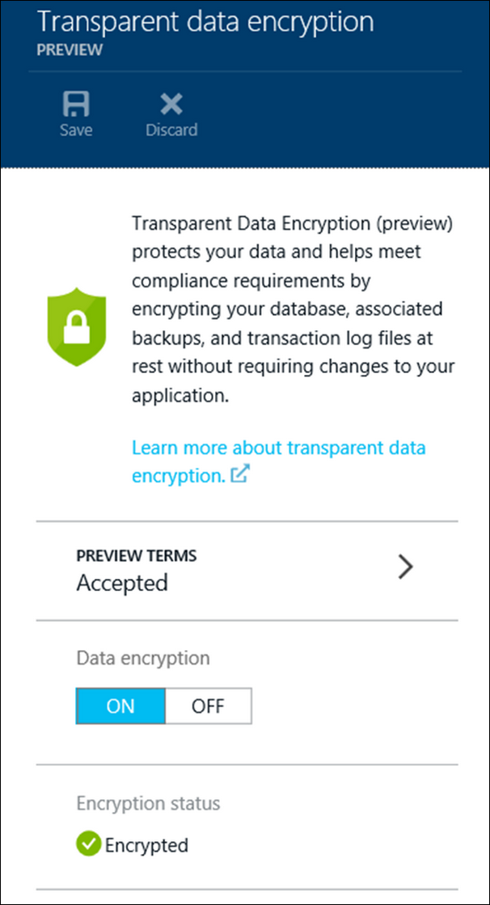
Transparent Data Encryption (TDE)
Encrypted database, backups, and transaction log at rest
2-click provisioning
Reduced attack surface area
No code changes to existing applications
Database encryption key - AES-256
Meet regulatory compliance
Accelerated hardware encryption
Encrypt and Protect Database
Notes:
Speaker notes:
Protect your data by encrypting your database, associated backups, and transaction log files at rest in real-time without requiring changes to your application
Help you meet regulatory compliance
An entire database is encrypted by using an industry standard AES-256 symmetric key by the service
Easy as a 2 clicks to provision the service and all key management for database copying, Geo-Replication, and database restores anywhere in SQL Database is handled by the service
Support for Intel AES-NI hardware acceleration of encryption. This will reduce the CPU/DTU overhead of turning on Transparent Data Encryption

Slide 22
Row-Level Security (RLS)
Fine-grained access over rows
Access restrictions logic contained in database
Simplified design and coding of security
Meet regulatory compliance
Reduced surface area of your security system
Fine-grained Access Over Rows
Notes:
Speaker notes:
Allow for data protection when multiple users or applications need to access different records in the same database tables. For example, implement restrictions on data rows to users pertinent to their department or restricting a customer's data access to only the data relevant to their company.
The access restriction logic is located in the database tier rather than away from the data in another application tier. Simplifies the design and coding of security in your application
Makes your security system more reliable and robust by reducing the surface area of your security system

Slide 23
Other notable features
Contained Database Users
Parallel Queries
Common Language Runtime (CLR) assemblies
Fine-grained Access Over Rows
Notes:
Speaker Notes:
SQL Database authenticate at the database level by using contained database users making databases more portable
Parallel Queries support heavier workloads
Author stored procedures, triggers, user-defined functions, user-defined types, and user-defined aggregates in managed code

Slide 24
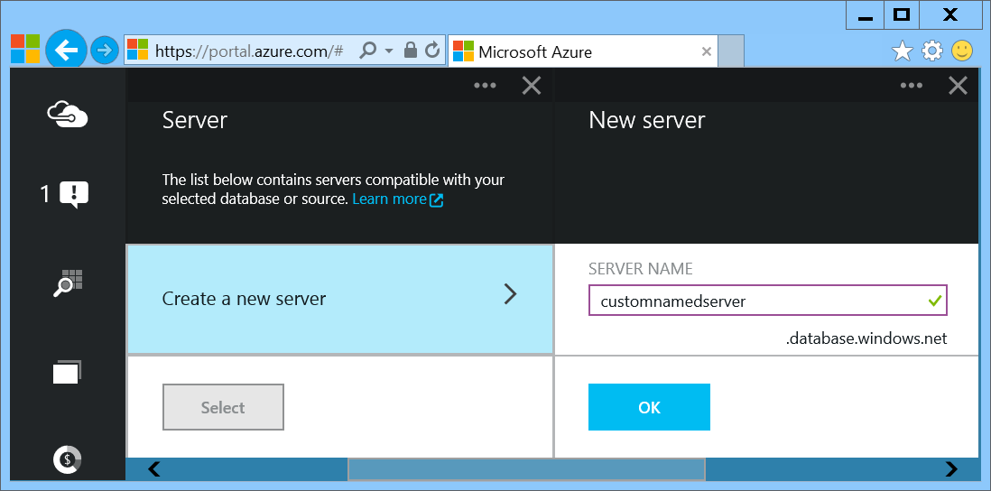
Provision Servers Interactively
In the Preview Management Portal create a SQL Database server
Notes:
Important: In the Preview Management Portal you are able to create a custom server FQDN! In the Management Portal that name is randomized.
Slide Objectives:
Show the different methods of provisioning a SQL Database server along with how easy it is. Plus, help the attendees understand what a SQL Database “server” really is.
In the Preview Portal you can select the name of the server you create!
Transition:
Provisioning an on-premises SQL Server box can be time consuming, costly, and at times, a challenge. With SQL Database, provisioning a “server” is painless, quick, and provisioned in a matter of seconds.
Speaking Points:
Provision servers interactively using the Management Portal
Automate server provisioning using the Microsoft Azure Management API or PowerShell.
Notes:
While the “server” is technically a TDS endpoint, much of the SQL Server process is similar. Administration login credentials are still needed for security, and more importantly defining service access is essential, and required, for maintaining the integrity of your server through firewall rules.

Slide 25
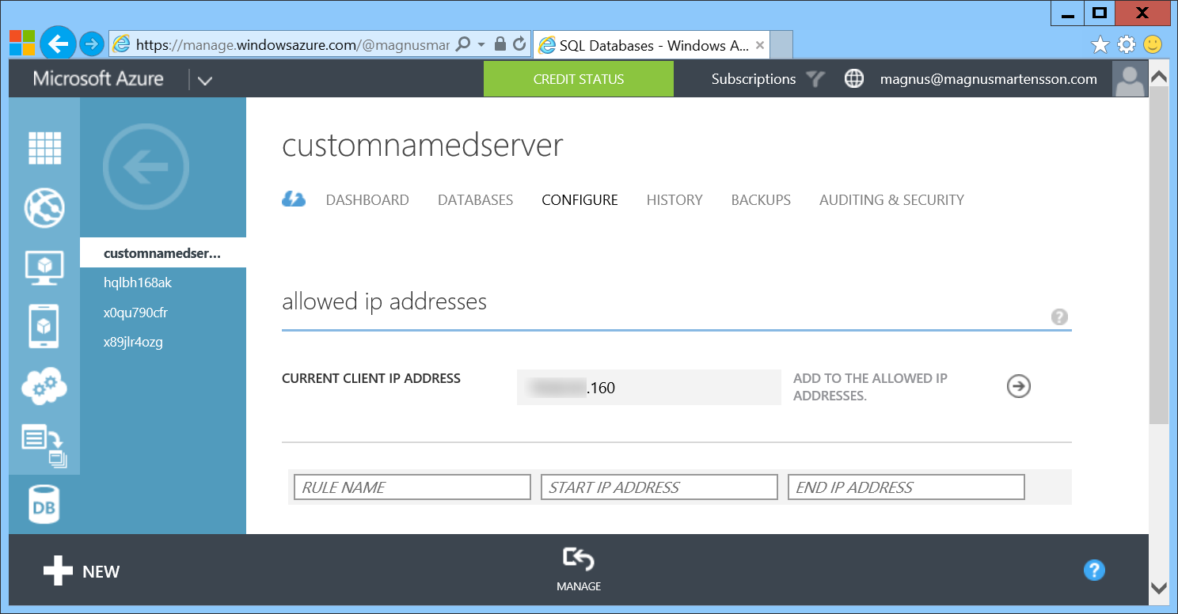
Provision Servers Interactively
In the Management Portal add firewall rules
Notes:
Slide Objectives:
Show how to configure IP-Filtering in the firewall for the SQL Database Server.

Slide 26
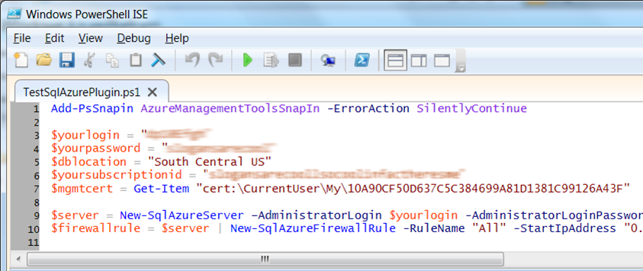
Automate Server Provisioning
Microsoft Azure Platform PowerShell cmdlets
http://bit.ly/azurepowershell
Notes:
Slide Objectives:
Show the different methods of provisioning a SQL Database server along with how easy it is. Plus, help the attendees understand what a SQL Database “server” really is.
Transition:
Provisioning an on-premises SQL Server box can be time consuming, costly, and at times, a challenge. With SQL Database, provisioning a “server” is painless, quick, and provisioned in a matter of seconds.
Speaking Points:
Provision servers interactively using the Management Portal
Automate server provisioning using the Microsoft Azure Management API or PowerShell.
Notes:
While the “server” is technically a TDS endpoint, much of the SQL Server process is similar. Administration login credentials are still needed for security, and more importantly defining service access is essential, and required, for maintaining the integrity of your server through firewall rules.

Slide 27
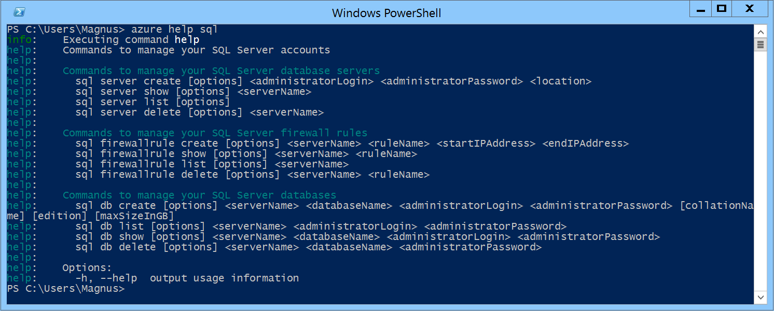
Automate Server Provisioning
Azure Cross-Platform Command-Line Interface (xplat-cli)
http://bit.ly/azurexplatcli
Notes:
Slide Objectives:
Show the different methods of provisioning a SQL Database server along with how easy it is. Plus, help the attendees understand what a SQL Database “server” really is.
Transition:
Provisioning an on-premises SQL Server box can be time consuming, costly, and at times, a challenge. With SQL Database, provisioning a “server” is painless, quick, and provisioned in a matter of seconds.
Speaking Points:
Automate server provisioning using the Microsoft Azure Management API or PowerShell or xplat-cli.

Slide 28
Demo: Creating A SQL Database Server and a SQL Database
Notes:
Demo 1)

Slide 29
Selecting the right SQL Database edition
Service Tier | Performance Level | Common App Pattern | Performance |  |  | Business Continuity
 |  |  | Max DB Size | Transaction Perf. Objective | DTU | PITR | DR / GEO-Rep
Basic | Basic | Small DB, SQL opp | 2 GB | Reliability / Hr. | 5 | 7 Days | DB Copy + Manual Export
Standard | S0 S1 S2 | Wrkgp/cloud app, multiple concurrent operations | 250 GB | Reliability / Min. | 10 20 50 | 14 Days | DB Copy + Manual Export
Premium | P1 P2 P3 | Mission Critical, High volume, Many concurrent Users | 500 GB | Reliability / sec. | 100 200 800 | 35 Days | Active Geo-replication
This information is subject to change over time.
Notes:
Slide Objectives:
Highlight what’s new in the latest SQL Database service update.
Transition:
In late September a service update was deployed to Microsoft Azure SQL Database that included new functionality.
Speaking Points:
Linked Server – This is a new component for database hybrid solutions spanning on-premises corporate networks and the Microsoft Azure cloud.
Recursive Trigger – Just like SQL Server 2012, the option can be configured via ALTER DATABASE dbname SET RECURSIVE_TRIGGERS ON|OFF
DBCC – The query optimizer uses statistics to estimate the cardinality or number of rows in the query result, which enables the query optimizer to create a high quality query plan.
Firewall Rules – different rules for different databases hosted on the same logical SQL Database server
Notes:

Slide 30
Auto backups, transactional logs every 5 min
Backups in Azure Storage and geo-replicated
Creates a side-by-side copy, non-disruptive
Backups retention policy: 7, 14 or 35 days
Automated export of logical backups for long-term backup protection
Point-in-time restore - “oops recovery”

Slide 31
Available in all tiers: Basic, Standard and Premium
Built on geo-redundant Azure Storage
Recover to any Azure region
Geo-restore – Emergency data recovery when you need it most
Notes:
Emergency data recovery when you need it most

Slide 32
Opt-in for Standard & Premium databases
Creates a stand-by secondary
Replicate to pre-paired Azure region
Automatic data replication, asynchronous
Opt-in via REST API, PowerShell or Azure Portal
Microsoft-managed, RTO<24h, RPO<1 hr
Standard geo-replication
Notes:
RTO Recovery time objective http://en.wikipedia.org/wiki/Recovery_time_objective
RPO Recovery point objective http://en.wikipedia.org/wiki/Recovery_point_objective

Slide 33
Self-service activation in Premium
Create up to 4 readable secondaries
Replicate to any Azure region
Automatic data replication, asynchronous
REST API, PowerShell or Azure Portal
RTO<1h, RPO<5m, you choose when to failover
Active geo-replication
Notes:
RTO Recovery time objective http://en.wikipedia.org/wiki/Recovery_time_objective
RPO Recovery point objective http://en.wikipedia.org/wiki/Recovery_point_objective

Slide 34
Configurable to track & log database activity
Dashboard views in the portal for at-a-glance insights
Pre-defined Power View reports for deep visual analysis on Audit log data
Audit logs reside in your Azure Storage account
Available in Basic, Standard, and Premium
Auditing
Notes:
Gain insight into database events & streamline compliance-related tasks

Slide 35
Full-Text Search
Fast and flexible indexing of textual data
Data types: char, varchar, nchar, nvarchar, text, ntext, image, xml, varbinary(max), or FILESTREAM
Handles high query volume
Common use cases:
Searching websites, product catalogs, news items and more
Document management systems
Any applications that need to provide search capabilities over data stored in a SQL Database
Notes:
Speaker notes:
Full-Text Search allows fast and flexible indexing for keyword-based query of text data stored in tables with columns of following data types: char, varchar, nchar, nvarchar, text, ntext, image, xml, or varbinary(max)
Full-text queries can include simple words and phrases or multiple forms of a word or phrase.
A full-text query returns any documents that contain at least one match (also known as a hit). A match occurs when a target document contains all the terms specified in the full-text query, and meets any other search conditions, such as the distance between the matching terms.
Full-text queries perform linguistic searches against text data in full-text indexes by operating on words and phrases based on rules of a particular language such as English or Japanese
A full-text query returns any documents that contain at least one match (also known as a hit). A match occurs when a target document contains all the terms specified in the full-text query, and meets any other search conditions, such as the distance between the matching terms.
Full-text search is applicable to a wide range of business scenarios such as e-businesses—searching for items on a web site; law firms—searching for case histories in a legal-data repository; or human resources departments—matching job descriptions with stored resumes.

Slide 36
XML Indexes
XML Indexes - improves XQuery-based query performance
Primary XML Index - speed up access to elements and attributes
CREATE PRIMARY XML INDEX XML_Order_Items
ON Sales.Order (Items);
Secondary XML Index – help resolve specific XQuery expressions rapidly
Notes:
Slide objective:
XML indexes speedup XQuery-based query response
Speaker notes:
An XML index is like a copy of an XML object tree that is saved into the database for rapid reuse rather than an object created in memory and traversed during query time which is a relatively slow process.
Before you can create a primary XML index on a table, the table must have a clustered primary key.
Secondary indexes are designed to speed up a particular type of query such as PATH, VALUE, and PROPERTY indexes:
A PATH index helps to decide whether a particular path to an element or attribute is valid. It is typically used with the exist() XQuery method.
A VALUE index helps to obtain the value of an element or attribute.
A PROPERTY index is used when retrieving multiple values through PATH expressions.

Slide 37
Dynamic Management Views (DMV)
Monitor common database, execution and transaction related events in near-real time
Diagnose blocked or long-running queries, resource bottlenecks, poor query plans, and more
Help improve capacity planning
Use familiar T-SQL language
Notes:
Slide objective:
Emphasize Azure SQL Database service has extremely rich environment for monitoring the status of your databases using DMVs.
Speaker notes:
Microsoft Azure SQL Database partially supports three categories of dynamic management views:
Database-related dynamic management views (indexes, partitions and waits)
Execution-related dynamic management views (connections, sessions, requests) Transaction-related dynamic management views (transactions and locks)
Identify expensive queries and gain an understanding of long running queries
View the status of your query within the execution plan
Detect the queries that run for long may be getting throttled by Azure SQL Database service
Monitor the size of transactions and transaction log usage
Helps with capacity planning - If these percentages remain near 100% utilization, you should consider improving performance by scaling out, scaling up, or optimizing your database design.

Slide 38
Demo: Connect from on premise and deploy your database
Notes:
Demo 2)

Slide 39
Use Familiar Technologies
Transact-SQL
(obviously)
Notes:
Slide Objectives:
Point out that 1) The same great technologies that developers use today on-premises works with SQL Database 2) high-level differences between on-premises and SQL Database 3) SQL Database features currently unsupported
Transition:
Creating, managing, and deploying a database in Microsoft Azure SQL Database isn’t difficult. The key is understanding the features that are supported and how SQL Database compares to on-premises SQL Server and the technologies that can be used with SQL Database.
Speaking Points:
The same great technologies that developers use today on-premises works with SQL Database, including developer languages, Frameworks, and Tools. Nothing new to learn!
SQL Server Comparison -> highlight the physical vs. logical administration. Developers and DBAs can now focus on things they love to do and not worry about the physical aspect.
Features unsupported by SQL Database -> Many of the unsupported features are hardware based and thus don’t need to be in SQL Database. Other features, such as encryption, are server-based and become a challenge in solving in a shared-environment.
Notes:
CLR data types ARE supported, SQLCLR is not yet supported.
Backup/Restore: PIT Coming; Import/Export can be used for backup to BLOB storage. Third-party backup products available via RedGate and Enzo.
Data can be stored encrypted but the encryption must be done at the application level.
Native encryption is being looked at.
**Linked Servers and Distributed Queries are now supported, linking a SQL Database instance from an on-premises server. Linking two SQL Database instances is NOT supported.

Slide 40
Use Familiar Technologies - Languages
.NET Framework (C#, Visual Basic, F#): ADO.NET
C / C++: ODBC
Java: Microsoft JDBC provider
PHP: Microsoft PHP provider
.NET Framework (C#, Visual Basic, F#): ADO.NET
C / C++: ODBC
Java: Microsoft JDBC provider
PHP: Microsoft PHP provider
Notes:
Slide Objectives:
Point out that 1) The same great technologies that developers use today on-premises works with SQL Database 2) high-level differences between on-premises and SQL Database 3) SQL Database features currently unsupported
Transition:
Creating, managing, and deploying a database in Microsoft Azure SQL Database isn’t difficult. The key is understanding the features that are supported and how SQL Database compares to on-premises SQL Server and the technologies that can be used with SQL Database.
Speaking Points:
The same great technologies that developers use today on-premises works with SQL Database, including developer languages, Frameworks, and Tools. Nothing new to learn!
SQL Server Comparison -> highlight the physical vs. logical administration. Developers and DBAs can now focus on things they love to do and not worry about the physical aspect.
Features unsupported by SQL Database -> Many of the unsupported features are hardware based and thus don’t need to be in SQL Database. Other features, such as encryption, are server-based and become a challenge in solving in a shared-environment.
Notes:
CLR data types ARE supported, SQLCLR is not yet supported.
Backup/Restore: PIT Coming; Import/Export can be used for backup to BLOB storage. Third-party backup products available via RedGate and Enzo.
Data can be stored encrypted but the encryption must be done at the application level.
Native encryption is being looked at.
**Linked Servers and Distributed Queries are now supported, linking a SQL Database instance from an on-premises server. Linking two SQL Database instances is NOT supported.

Slide 41
Use Familiar Technologies - Frameworks
OData
Entity Framework
WCF Data Services
NHibernate (etc.)
Notes:
Slide Objectives:
Point out that 1) The same great technologies that developers use today on-premises works with SQL Database 2) high-level differences between on-premises and SQL Database 3) SQL Database features currently unsupported
Transition:
Creating, managing, and deploying a database in Microsoft Azure SQL Database isn’t difficult. The key is understanding the features that are supported and how SQL Database compares to on-premises SQL Server and the technologies that can be used with SQL Database.
Speaking Points:
The same great technologies that developers use today on-premises works with SQL Database, including developer languages, Frameworks, and Tools. Nothing new to learn!
SQL Server Comparison -> highlight the physical vs. logical administration. Developers and DBAs can now focus on things they love to do and not worry about the physical aspect.
Features unsupported by SQL Database -> Many of the unsupported features are hardware based and thus don’t need to be in SQL Database. Other features, such as encryption, are server-based and become a challenge in solving in a shared-environment.
Notes:
CLR data types ARE supported, SQLCLR is not yet supported.
Backup/Restore: PIT Coming; Import/Export can be used for backup to BLOB storage. Third-party backup products available via RedGate and Enzo.
Data can be stored encrypted but the encryption must be done at the application level.
Native encryption is being looked at.
**Linked Servers and Distributed Queries are now supported, linking a SQL Database instance from an on-premises server. Linking two SQL Database instances is NOT supported.

Slide 42
Use Familiar Technologies - Tools
SQL Server Management Studio (>=2008 R2)
SQL Server command-line utilities (SQLCMD, BCP)
Visual Studio IDE for database development
Notes:
Slide Objectives:
Point out that 1) The same great technologies that developers use today on-premises works with SQL Database 2) high-level differences between on-premises and SQL Database 3) SQL Database features currently unsupported
Transition:
Creating, managing, and deploying a database in Microsoft Azure SQL Database isn’t difficult. The key is understanding the features that are supported and how SQL Database compares to on-premises SQL Server and the technologies that can be used with SQL Database.
Speaking Points:
The same great technologies that developers use today on-premises works with SQL Database, including developer languages, Frameworks, and Tools. Nothing new to learn!
SQL Server Comparison -> highlight the physical vs. logical administration. Developers and DBAs can now focus on things they love to do and not worry about the physical aspect.
Features unsupported by SQL Database -> Many of the unsupported features are hardware based and thus don’t need to be in SQL Database. Other features, such as encryption, are server-based and become a challenge in solving in a shared-environment.
Notes:
CLR data types ARE supported, SQLCLR is not yet supported.
Backup/Restore: PIT Coming; Import/Export can be used for backup to BLOB storage. Third-party backup products available via RedGate and Enzo.
Data can be stored encrypted but the encryption must be done at the application level.
Native encryption is being looked at.
**Linked Servers and Distributed Queries are now supported, linking a SQL Database instance from an on-premises server. Linking two SQL Database instances is NOT supported.

Slide 43
Unsupported SQL Server Features
Use command, distributed transactions, distributed views
Service Broker
SQL Agent
SQL Profiler
Native Encryption
Notes:
Slide Objectives:
Point out that 1) The same great technologies that developers use today on-premises works with SQL Database 2) high-level differences between on-premises and SQL Database 3) SQL Database features currently unsupported
Transition:
Creating, managing, and deploying a database in Microsoft Azure SQL Database isn’t difficult. The key is understanding the features that are supported and how SQL Database compares to on-premises SQL Server and the technologies that can be used with SQL Database.
Speaking Points:
The same great technologies that developers use today on-premises works with SQL Database, including developer languages, Frameworks, and Tools. Nothing new to learn!
SQL Server Comparison -> highlight the physical vs. logical administration. Developers and DBAs can now focus on things they love to do and not worry about the physical aspect.
Features unsupported by SQL Database -> Many of the unsupported features are hardware based and thus don’t need to be in SQL Database. Other features, such as encryption, are server-based and become a challenge in solving in a shared-environment.
Notes:
CLR is now supported: http://azure.microsoft.com/blog/2014/12/11/preview-available-for-next-generation-of-azure-sql-database/
Backup/Restore: PIT Coming; Import/Export can be used for backup to BLOB storage. Third-party backup products available via RedGate and Enzo.
Data can be stored encrypted but the encryption must be done at the application level.
Native encryption is being looked at.
**Linked Servers and Distributed Queries are now supported, linking a SQL Database instance from an on-premises server. Linking two SQL Database instances is NOT supported.

Slide 44
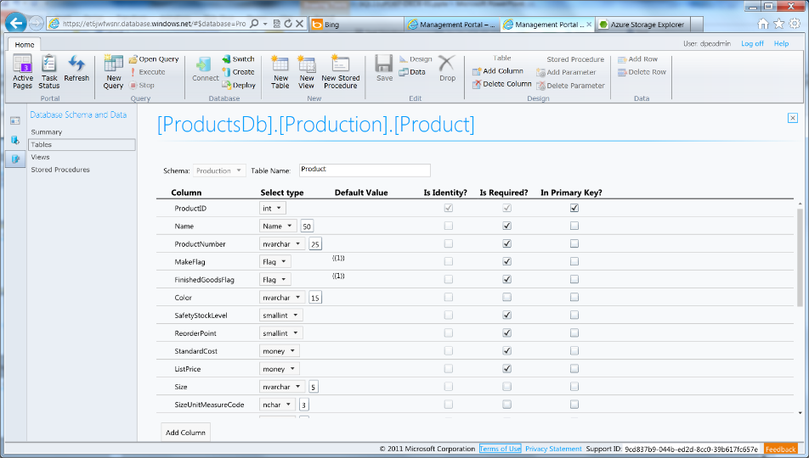
Azure SQL Database Management Portal
Web designers for tables, views, stored procs
Interactive query editing and execution
Notes:
Slide Objectives:
Highlight the set of tools for developers when interacting with Microsoft Azure SQL Database.
Transition:
Transition statement(s) to setup the slide
Speaking Points:
SQL Database Management Portal -> Cross Browser, Unified Management Experience
SQL Server Data Tools -> Integrated Database Design Environment, Table Designer, Debugging, T-SQL Editor
Notes:
IntelliSense in T-SQL Editor
SQL Server Data Tools
Strive to make it consistent as possible
Intersection with the cloud
Bridging you to the new cloud world
Consistency to the new developer experience
Consistency with the new cloud model

Slide 45
Demo: DAC Deployment From SQL Server Management Studio
Notes:
Demo 3)

Slide 46
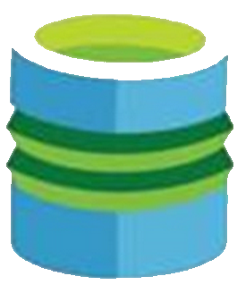
Elastic Database

Slide 47
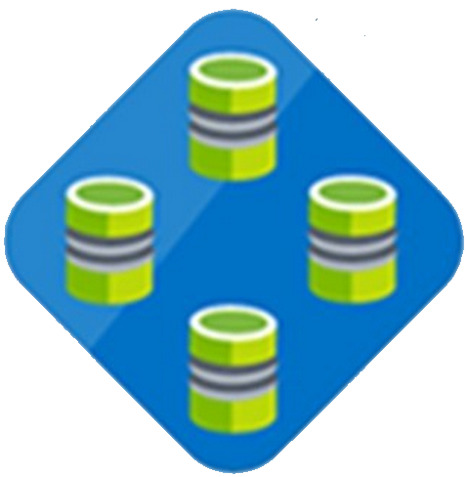

Elastic Database Pool
Elastic Database
Pool
Elastic Database
Predictable model for deploying large numbers of databases
Notes:
Speaker notes:
Elastic pools simplify the process of creating, maintaining, and managing both performance and cost for large numbers of Azure SQL databases.
Manage large numbers of databases that have unpredictable resource demands.
Ability to run centralized queries and reporting tools across database pool.

Slide 48
PREVIEW
Elastic Database Model
Elastic databases, Elastic database pools
Pooled resources leveraged by many databases
Standard elastic pool provides 200-1200* eDTUs for up to 100* databases
Elastic Standard databases can burst up to 100 eDTUs (S3 level)
Create/configure pool via portal, PowerShell, REST APIs
Move databases in/out using portal, PowerShell, REST APIs, T-SQL
Databases remain online throughout
Monitoring and alerting is available on both pool and databases
Max per-database burst level
eDTUs
200
400
800
1200
*Additional pricing tiers may be introduced, and the ranges and limits may be increased during the preview

Slide 49
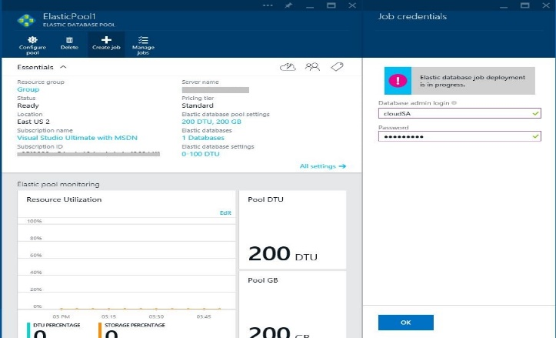
Elastic Database Jobs
ELASTIC DATABASE JOBS
SQL
SQL
SQL
T-SQL Scripts
SQL
ELASTIC DATABASE POOL
Execute administrative tasks across each database
Notes:
Speaker notes:
Execute administrative tasks across each database
Don’t have to connect to each database independently in order to run T-SQL statements or perform other administrative tasks
For example, you can easily update the schema in every database to include a new table
Elastic database jobs handles the task of logging in, and reliably running the script for you, while logging the status of execution for each database

Slide 50
Managing many databases
Apply changes or administrative operations to many databases
Use familiar T-SQL scripts to define jobs
Built-in automatic retries in case of transient failures
Tightly integrated with elastic pools in the new Azure Portal
Designed for batch processing
Elastic Database Jobs

Slide 51
Elastic Scale
Notes:
This section is optional. If you have an audience with a specific interest in this there are many more slides hidden in a section at the end!

Slide 52
Canonical cloud app architecture
Classic 3-tier enterprise architecture:
Scale out the front ends to multiple instances is easy
Scale the data-tier is more challenging
Notes:
Classic 3-tier enterprise architecture
Requires to scale to 10000s users and process TBs of relational data
Scaling out (and in, elastically) web and worker tiers is relatively easy
How to scale data-tier if hard limits of the biggest scale unit (e.g. P3 instance) are reached: both storage size and throughput?

Slide 53
SQL Database Considerations and Best Practices
Elastic Scale across thousands of databases via custom sharding
Scale out via .NET Client libraries consumed by customer applications to support sharded database pattern
Enables developer and manageability functions
Supports split, merge, and move operations on data

Slide 54
Scalability options in Azure SQL DB
Vertical: Scale-up or scale-down
Horizontal: Scale-out or scale-in
Premium
Premium
Standard
Standard
Scale up/down
Basic
Basic
Basic
Basic
Basic
Basic
Basic
Scale out/in
Notes:
Vertical: Change service-tiers for a given database as capacity needs fluctuate
Horizontal: Add or remove databases as more or less capacity is needed
Animation:
We start off with 3 basic databases
[click]: We can vertically scale one of these to a standard instance
[click]: We can also add more instances by scaling horizontally
[click]: If an instance need more headroom, we can always still vertically scale

Slide 55
Elastic Scale architecture

Slide 56
SQL Server VM
Notes:
Now let’s focus on SQL Server in a Microsoft Azure Virtual Machine!

Slide 57
Run SQL on VM
Run any SQL product on cloud VM
Support for SQL Server, Oracle, MySql
Ready to go VM images available in Gallery
Persistent storage using attached disk in blob storage
Has all the benefits and powers of VMs combined with the full features of a SQL Engine

Slide 58
Why (at least) two offerings of SQL in Azure?
SQL IaaS
SQL Database

Slide 59
SQL Database
SQL IaaS
When you want reduced overhead and possibly need elastic scale.
Customer does not want to add additional IT resources for support and maintenance.
Avoiding CAPEX and OPEX.
Existing applications which requires full box product functionality.
Customer has ecosystem of IT resources for support and maintenance.
Removing CAPEX.

Slide 60
Other features SQL IaaS supports that SQL Database doesn’t (yet)
Full SQL Server functionality (e.g. Reporting Services)
Windows authentication available (requires VM to be joined to on-premises domain)
Larger database sizes possible (16TB)
Notes:
Note: Full-Text Search now supported https://msdn.microsoft.com/library/ms142571.aspx

Slide 61
Demo: Standing up a SQL Server in Azure using Marketplace
Notes:
Demo 4)

Slide 62
DocumentDB
Notes:
Now let’s focus on the new Microsoft Azure DocumentDB Service!

Slide 63
Fully managed, scalable JSON document database service

Slide 64


Microsoft Azure Data Services
SQL Server in a VM
SQL Database
DocumentDB
Tables
Blobs
fully managed, scalable, queryable, schemafree JSON document database service for modern applications
fully featured RDBMS
transactional processing
rich query
managed as a service
elastic scale
schema-free data model
internet accessible http/rest
arbitrary data formats

Slide 65
MongoDB
DocumentDB
Existing applications which require extra capacity for scale out and can not be migrated
Customer has ecosystem of IT resources for support and maintenance
Removing CAPEX
Mongo MMS compatibility
Applications that need managed elastic scale, query over schema free data, native JSON/JavaScript support
Customer does not want to add additional IT resources for support and maintenance
Avoiding CAPEX and OPEX
Built-for-the-cloud database technology

Slide 66
Tunable Consistency – four distinct levels
Strong Bounded Stateless Session Eventual
Notes:
Configurable consistency to trade off consistency and performance.
Database Accounts are configured with a default consistency level.
Consistency level can be weakened per read/query request.

Slide 67
Tunable Consistency Strong
All writes are visible to all readers. Writes synchronously committed by a majority quorum of replicas and reads are acknowledged by the majority read quorum.

Slide 68
Tunable Consistency Bounded Stateless
Guaranteed ordering of writes, reads adhere to minimum freshness. Writes are propagated asynchronously, reads are acknowledged by majority quorum lagging by at most K prefixes.

Slide 69
Tunable Consistency Session
Read your own writes. Writes are propagated asynchronously while reads for a session are issued against the replica that can serve the requested version.

Slide 70
Tunable Consistency Eventual
Reads eventually converge with writes. Writes are propagated asynchronously while reads can be acknowledged by any replica. Readers may view older data then previously observed.

Slide 71
Tunable Consistency
 | Writes | Reads
Strong | sync quorum writes | quorum reads
Bounded | async replication | quorum reads
Session | async replication | session bound replica
Eventual | async replication | any replica
*
* | Ideal consistency and performance tradeoff for many application scenarios. High performance writes and reads with predictable consistency.

Slide 72
Partitioning Data
Hash Range Lookup
Notes:
Speaker notes:
Achieve near-infinite scale in terms of storage and throughput by horizontally partitioning data(sharding)
Best partition option for data across collections will depend on data format and access patterns
DocumentDB accounts can be scaled linearly with cost via collections

Slide 73
Partitioning Hash
Partitions are assigned based on the value of a hash function, allowing you to evenly distribute requests and data across a number of partitions
Notes:
Speaker notes:
This is commonly used to partition data produced or consumed from a large number of distinct clients, and is useful for storing user profiles, catalog items, and IoT ("Internet of Things") telemetry data.
You should use hash partitioning whenever there are too many entities to enumerate through lookup partitioning (e.g. users or devices) and the request rate is fairly uniform across entities.
Hash partitioning is useful for uniform load balancing of requests to make effective use of your provisioned storage and throughput. Using consistent hashing algorithms allow you to minimize the amount of data that has to be moved when adding or removing a partition.

Slide 74
Partitioning Range
Partitions are assigned based on whether the partition key is within a certain range.
Notes:
Speaker notes:
This is commonly used for partitioning with time stamp properties (e.g., eventTime between Feb 1, 2015 and Feb 2, 2015).
You should use Range partitioning if your queries are restricted to specific range values against the partition key.
Range partitioning is generally used in the context of dates, as it gives you an easy and natural mechanism for aging out partitions by timestamp. It is also useful when queries are generally constrained to a time range since that is aligned with the partitioning boundaries.

Slide 75
Partitioning Lookup
Partitions are assigned based on a lookup map that assigns discrete partition values to specific partitions a.k.a. a partition or shard map.
Notes:
Speaker notes:
This is commonly used for partitioning by region (e.g. the partition for Scandinavia contains Norway, Denmark, and Sweden).
Lookup partitioning offers the highest degree of control in managing a multi-tenant application. You can assign multiple tenants to a single collection, single tenant to a single collection, or even a single tenant across multiple collections.
Lookup partitioning allows you to group and organize unordered and unrelated sets of data in a natural way e.g., group tenants by organization or states by geographic region. Lookup also offers fine-grained control for migrating data between collections.

Slide 76
Demo: Interacting with DocumentDB
Notes:
Demo 5)

Slide 77
Search
Notes:
Time for the Microsoft Azure Search as a Service offering!

Slide 78
Azure Search
Embed a sophisticated search experience into web and mobile applications without having to worry about the complexities of full-text search and without having to deploy, maintain or manage any infrastructure.
Notes:
Azure Search is a fully managed search solution that allows developers to enable search experiences in applications.

Slide 79
Azure Search
Perfect for enterprise cloud developers, cloud software vendors, cloud architects who need a fully-managed search solution.

Slide 80
Search Functionality
Simple HTTP/JSON API for creating indexes, pushing documents, searching
Keyword search with user-friendly operators (+, -, *, “”, etc.)
Hit highlighting
Faceting (histograms over ranges, typically used in catalog browsing)

Slide 81
Search Functionality
Suggestions (auto-complete)
Rich structured queries (filter, select, sort) that combines with search
Scoring profiles to model search result relevance
Geo-spatial support integrated in filtering, sorting and ranking

Slide 82
Demo: Azure Search walkthrough
Notes:
Demo 6)

Slide 83
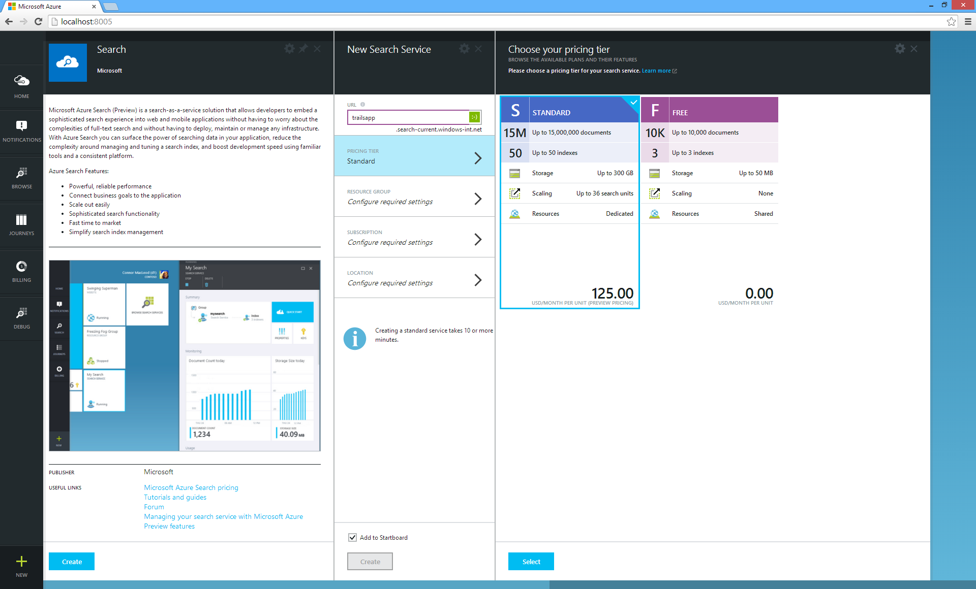
Choose Tier
Notes:
In the Azure Portal choose ”new +” -> ”Search”.
Pricing tier is either Standard or Free where the latter naturally is useful for functional development tests.

Slide 84
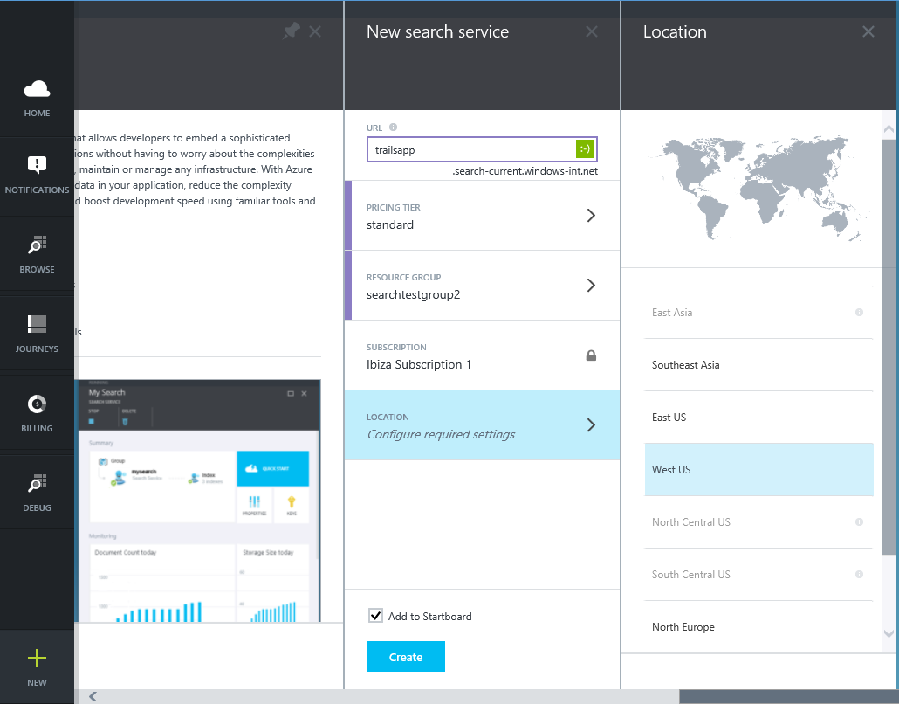
Global Availability
Notes:
Pick a location for the service.

Slide 85
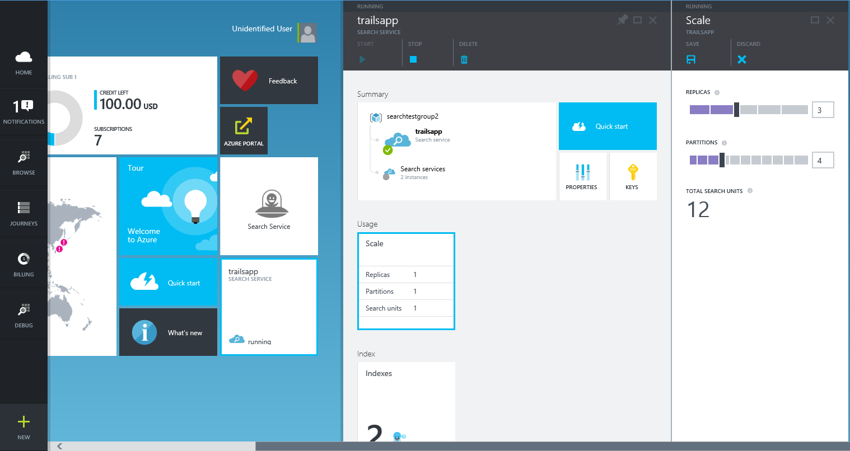
Scale Up

Slide 86
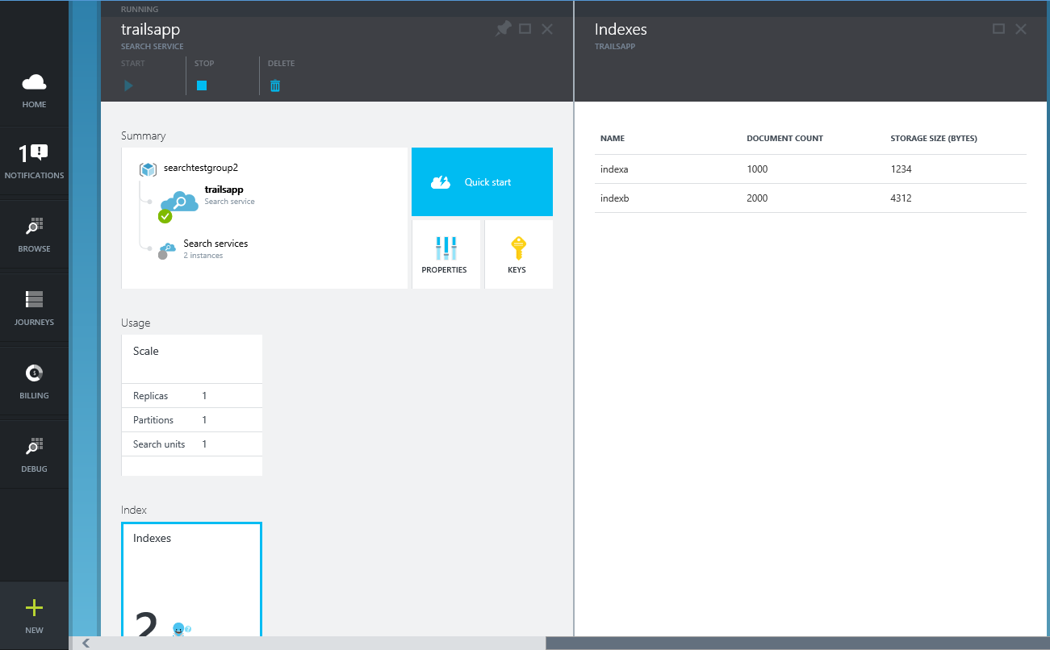
Manage Indexes

Slide 87
HDInsight
Notes:
Now let’s focus on Hadoop in Azure known as Microsoft Azure HDInsight!

Slide 88

Big Data Insights
Microsoft Azure HDInsight
Microsoft instance of Hadoop distribution running as service
Support existing ecosystem from Hive, Pig, etc
Includes HBase and Storm
Extended to support Excel and BI tooling
Integration with diverse sources of data
Notes:
Speaker notes.
HDInsight is Microsoft instance of Apache Hadoop distribution running as a service in Azure cloud that you can spin up in minutes. It’s architected to handle any amount of data, scaling from terabytes to petabytes on demand.
Supports existing ecosystem such as Hive to explore your data or to create reusable batch processing jobs. Includes Pig to implement complex processing logic.
Uncover business insights by processing and analyzing structured or semi-structured data from web clickstreams, social media, server logs, devices and sensors, and more.
Because it's integrated with Excel, HDInsight lets you visualize and analyze your Hadoop data in compelling new ways in a tool familiar to your business users.
Includes NoSQL transactional capabilities with Apache Hbase. Provides real-time stream processing capabilities with Apache Storm
Leverage existing skills for configuration, submission, and monitoring of Hadoop jobs using languages you know such as Java, C#, PowerShell, .Net SDK

Slide 89
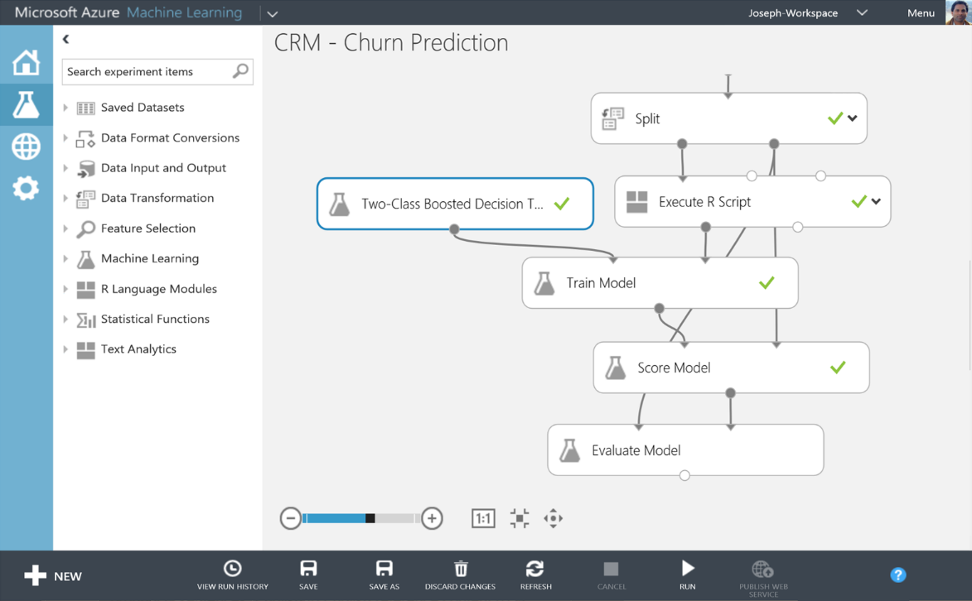
Big Data Insights
Microsoft Azure Machine Learning
Democratized platform for Machine Learning
Fully-managed cloud service for building predictive
analytics solutions
Elastic, pay as you go with low operating costs
Extend with Power BI, HDInsight and cloud hosted data
Extensible, supports R and Python
Notes:
Speaker notes:
Democratized; Azure Machine Learning lets the masses and scientists alike learn, experiment, mashup and create high quality powerful algorithms.
Visually compose ML workflow through a web browser with no software to install and without learning multiple tools from data acquisition, cleaning and prep, machine learning, and experimentation.
Fully-managed cloud service for building predictive analytics solutions, helps overcome the challenges most businesses have in deploying and using machine learning.
Enables data scientists and developers to efficiently embed predictive analytics into their applications.
Azure ML is supports today’s Data scientists’ choice of language R and can bring their existing assets in R and integrate them seamlessly into Azure ML workflows.

Slide 90
Relational DB vs. Hadoop
Data size | Gigabytes (Terabytes) | Petabytes (Hexabytes)
Access | Interactive and Batch | Batch
Updates | Read / Write many times | Write once, Read many times
Structure | Static Schema | Dynamic Schema
Integrity | High (ACID) | Low
Scaling | Nonlinear | Linear
Reference: Tom White’s Hadoop: The Definitive Guide

Slide 91
Programming HDInsight – Existing ecosystem
Hive
Pig
Mahout
Cascading
Scalding
Scoobi
Pegasus
…

Slide 92
Programming HDInsight – Microsoft .NET
C#
F#
Map/Reduce
Microsoft .NET management clients

Slide 93
Programming HDInsight – DevOps / IT Pros
PowerShell
Cross-Platform CLI tools (xplat-cli)

Slide 94
Data Warehousing

Slide 95
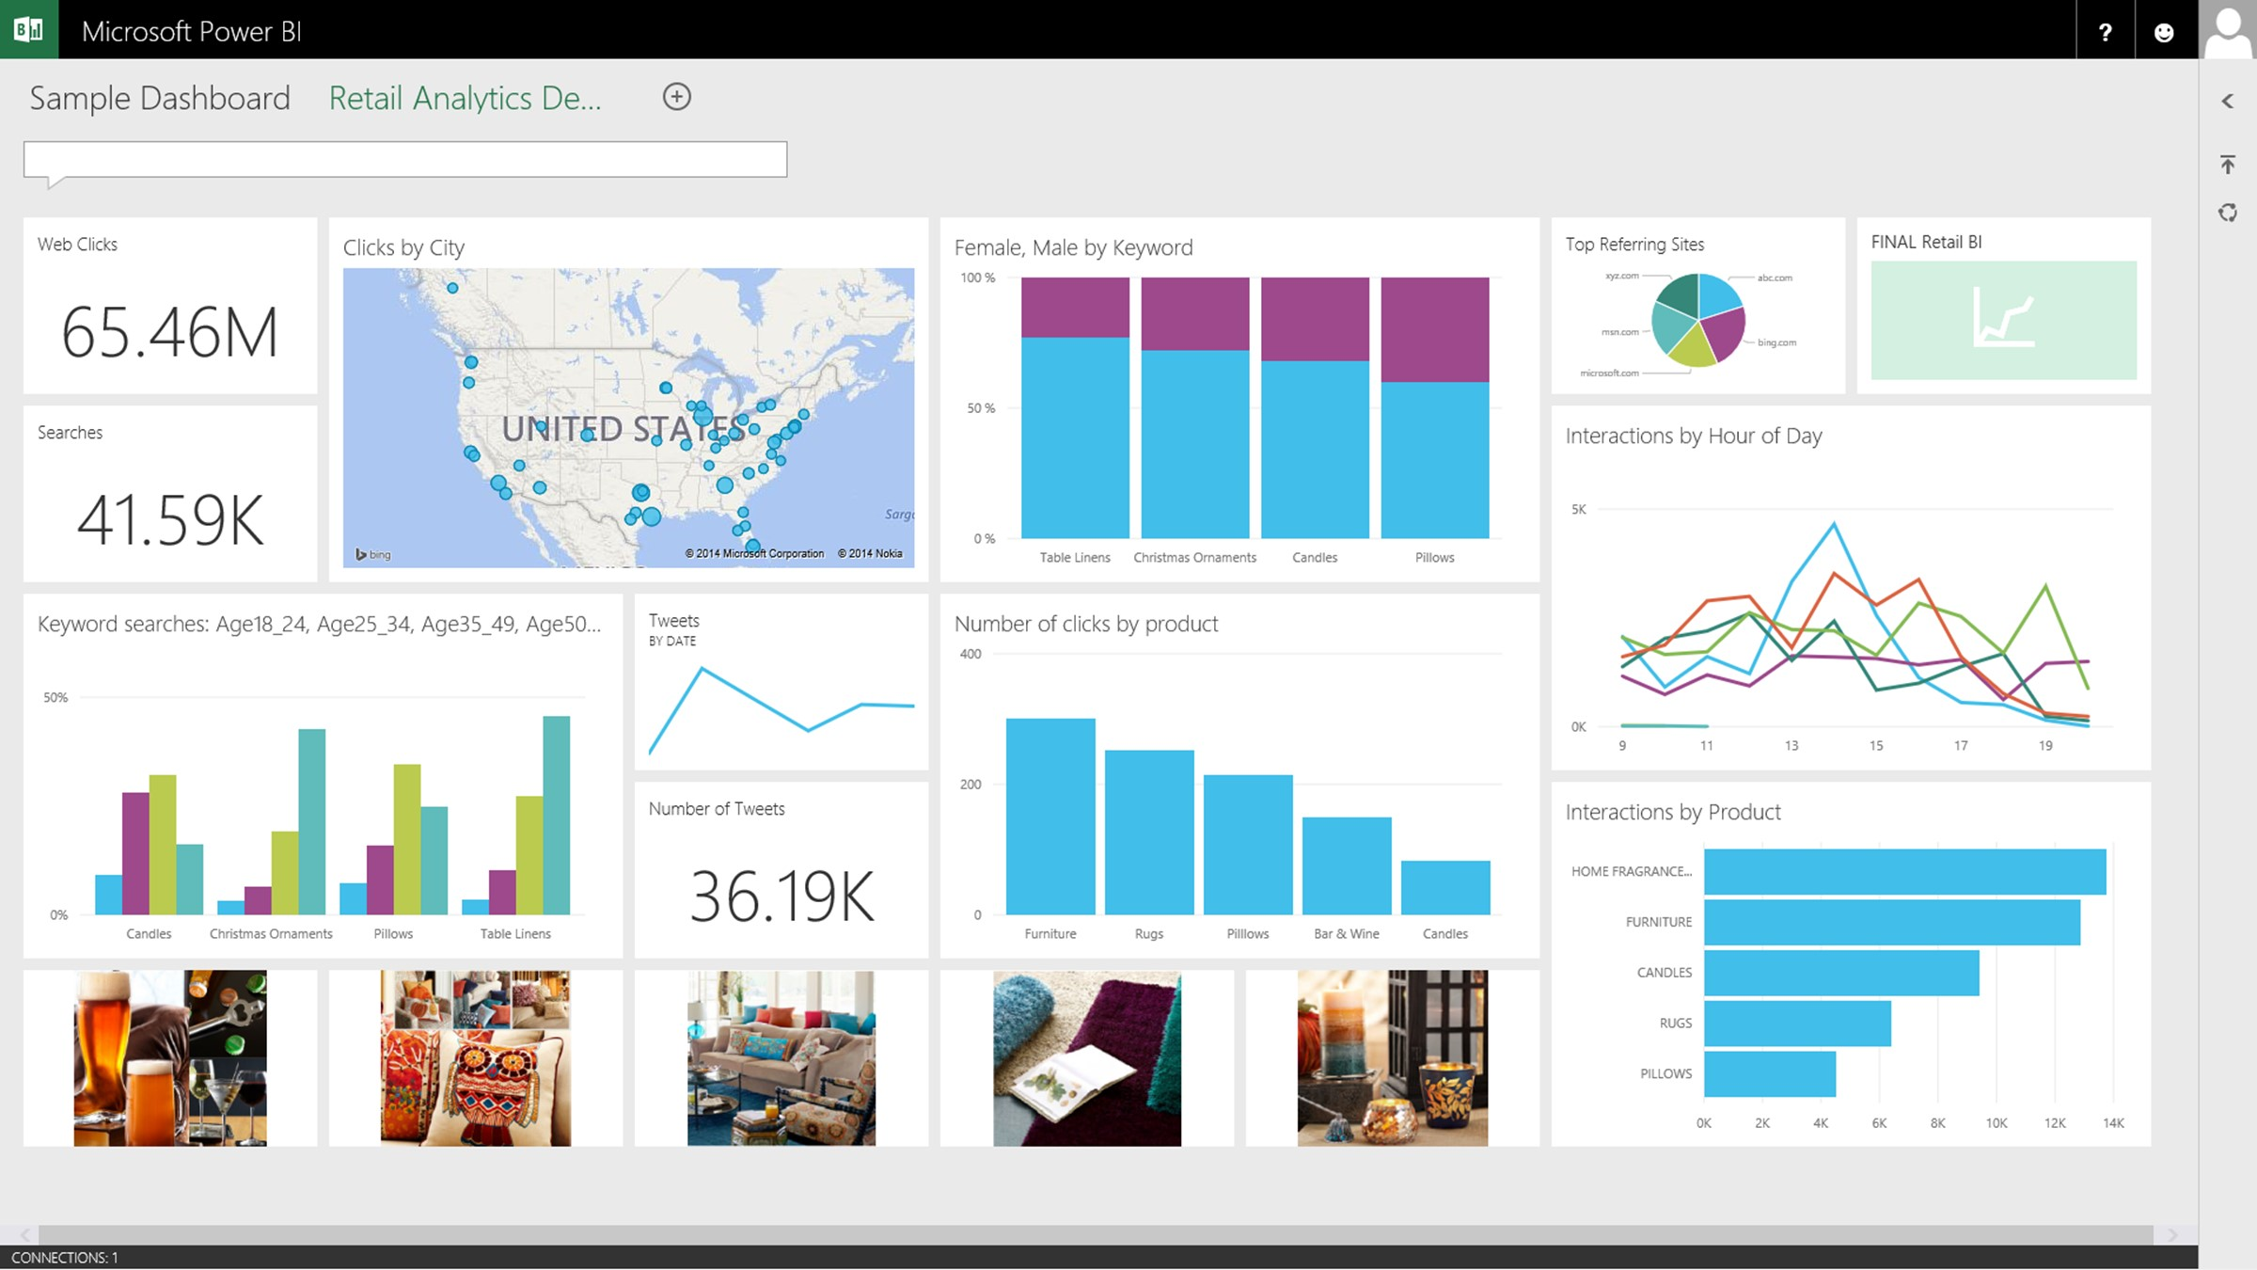

A relational data warehouse-as-a-service
Power BI
Hadoop
App Service
Azure SQL Database
Azure SQL Data Warehouse
Intelligent App
Azure Machine Learning
Notes:
Speaker notes:
Fully managed relational data warehouse-as-a-service.
Industry’s first elastic cloud data warehouse with enterprise-grade capabilities
Support your smallest to largest data sets

Slide 96
Elastic scale & performance
Powered by the Cloud
Market Leading Price & Performance
Scales to petabytes of data
Massively Parallel Processing
Instant-on compute scales in seconds
Query Relational / Non-Relational
Get started in minutes
Integrated with Azure ML, PowerBI & ADF
Enterprise Ready
Simple billing compute & storage
Pay for what you need, when you need it with dynamic pause
Bring DW to the Cloud without rewriting

Slide 97
Data Lake
Data Lake

Slide 98
Azure Data Lake service
Store and manage infinite data
Keep data in its original form
High through put, low latency analytic jobs
Enterprise-grade security + access control
Data Lake
Notes:
Speaker notes:
It’s as an enterprise wide repository of every type of data collected in a single place prior to any formal definition of requirements or schema.
Data is be kept without discrimination regardless of its size, structure, or how fast it is ingested.
Organizations can then use Hadoop or advanced analytics to find patterns of the data.
Azure Data Lake can be part of your existing data platform by leveraging Azure Active Directory as well as providing data replication to ensure high durability and availability.

Slide 99
Data Lake service Transformative way to store and process infinite data
HDInsight Service
Microsoft Revolution-R Enterprise
Other analytic solutions
SQL Data Warehouse
Data Lake
HDFS API
Notes:
Speaker notes:
HDFS for the Cloud: The Azure Data Lake is a Hadoop File System compatible with HDFS enabling Microsoft offerings such as Azure HDInsight, Revolution-R Enterprise, industry Hadoop distributions like Hortonworks and Cloudera all to connect to it.
Petabyte files, massive throughput: The goal of the data lake is to run Hadoop and advanced analytics on all your data to discover conclusions from the data itself.
Curated data: Azure Data Lake can also serve as a repository for lower cost data preparation prior to moving curated data into a data warehouse such as Azure Data Warehouse.

Slide 100
MongoDB, MySQL, Oracle, Cassandra, Neo4j and more
Notes:
There are other SQL Solutions you can choose to run in Azure. Official support exists for MySQL and Oracle.
(Good place to show the portal and that you can provision Oracle and MySQL databases in Azure just as easily as you can provision the Microsoft SQL options.

Slide 101
Additional Database options in Azure
Azure Table Service is a “Big Table” entity store.
MongoDB is a document (JSON) store.
Cassandra is a columnar store with excellent replication.
HBase is a Big Data (Hadoop) store available in HDInsight.
Oracle VMs are supported in Azure.
MySQL is offered from the partner ClearDB.

Slide 102
Microsoft Azure Data Platform
SQL Database
SQL on IaaS
DocumentDB
Search
HDInsight
MongoDB, MySQL, Oracle, Cassandra, Neo4j and more
Notes:
As you can see there are a lot of options in the Microsoft Azure DataPlatform offerings. It may be a challenge to identify the most suitable options in every case but we can rest assured that there will be a good option for almost any scenario!

Slide 103
Try [service] today
Ask Questions:
Twitter:
Email
Public forum:

Slide 104
Q&A

Slide 106


Get started
Visit azure.microsoft.com

